Slide 1




Fitness Tracker Replay
Project #2
z

Slide 2

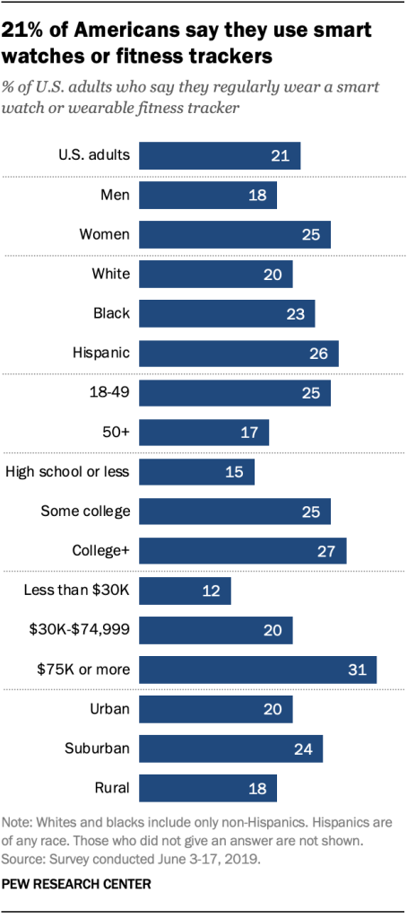






Concept: Create a dashboard to explore performance statistics using data from individual workout activities. Data collected from fitness trackers (Fitbit, smartwatches, GPS enabled cycling computers) We will leverage visualizations to enhance users understanding of their workout performance.
z
* Pew research 9/9/2020 https://www.pewresearch.org/fact-tank/2020/01/09/about-one-in-five-americans-use-a-smart-watch-or-fitness-tracker/

Slide 3




Data Retrieval
A python script was used to scrape personal activity data from Garmin’s website.
This returned two kinds of data objects.
A single JSON file containing the summary stats for each individual activity.
Approximately 630 “*.tcx” files (written in XML) each file contains hundreds of “trackpoints”. TrackPoint data is recorded about every second during an activity and contains the lat/lon at that point in time, as well as any data from associated sensors - i.e. heart rate, power, cadence
{
activityId: 5636969541,
activityName: "Grand Junction Cycling",
description: null,
startTimeLocal: "2020-10-05 11:43:07",
startTimeGMT: "2020-10-05 17:43:07",
activityType: {
typeId: 2,
typeKey: "cycling",
parentTypeId: 17,
sortOrder: 8,
isHidden: false,
},
eventType: {
typeId: 4,
typeKey: "training",
sortOrder: 7,
},
comments: null,
parentId: null,
distance: 67872.90625,
duration: 9028.3369140625,
elapsedDuration: 9723127.9296875,
movingDuration: 8932.521057128906,
elevationGain: 868,
elevationLoss: 865,
averageSpeed: 7.51800012588501,
maxSpeed: 17.000999450683594,
startLatitude: 39.07227901741862,
startLongitude: -108.558548418805,
<Activities>
<Activity Sport="Biking">
<Id>2018-08-11T16:19:40.000Z</Id>
<Lap StartTime="2018-08-11T16:19:40.000Z"> <TotalTimeSeconds>330.0</TotalTimeSeconds> <DistanceMeters>1609.35</DistanceMeters> <MaximumSpeed>8.9399995803833</MaximumSpeed> <Calories>53</Calories>
<Intensity>Active</Intensity> <TriggerMethod>Manual</TriggerMethod>
<Track>
<Trackpoint>
<Time>2018-08-11T16:19:40.000Z</Time> <Position> <LatitudeDegrees>44.91394383832812</LatitudeDegrees> <LongitudeDegrees>-116.0895159188658</LongitudeDegrees> </Position>
<AltitudeMeters>1466.800048828125</AltitudeMeters> <DistanceMeters>0.0</DistanceMeters>
<Extensions>
<ns3:TPX>
<ns3:Speed>0.0</ns3:Speed>
</ns3:TPX>
</Extensions>
</Trackpoint>
* Garmin Connect web scraping code: https://github.com/petergardfjall/garminexport

Slide 4
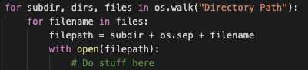
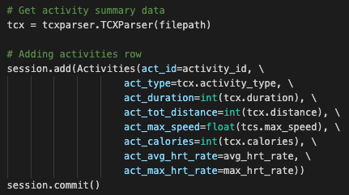
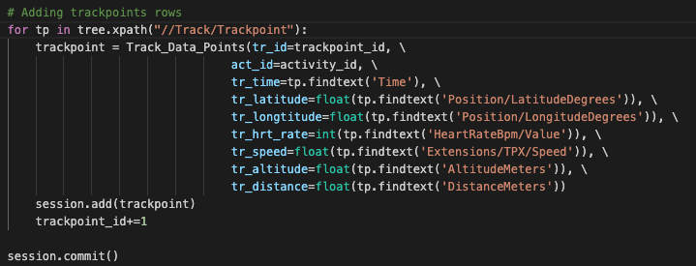
Data Extraction Process
Extract data from .tcx files and add to Postgres DB
Os.walk
Tcxparser
Lxml
SQLAlchemy

Slide 5
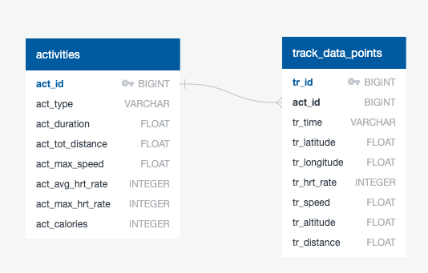
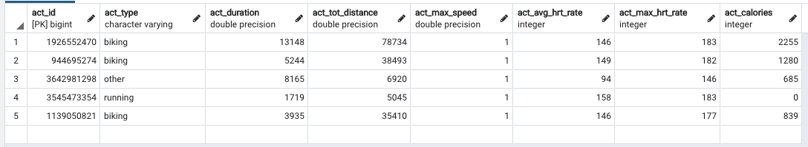
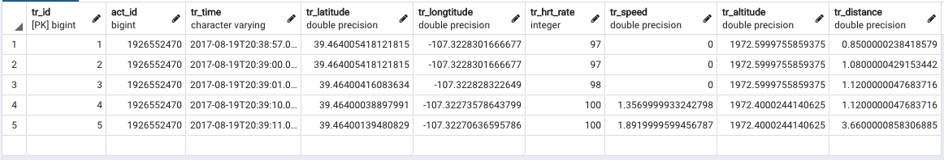
Database Structure
Fitness Tracker Data Model
Activities Table
Trackpoints Table

Slide 6
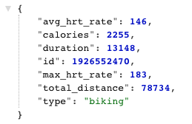
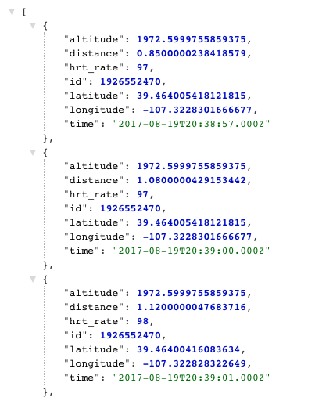
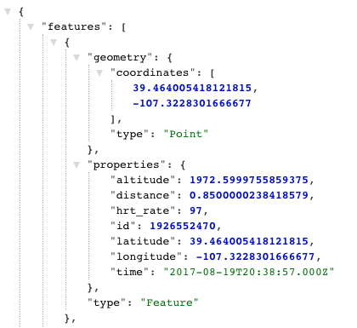
Flask API
Activity Summary
Individual Trackpoints
Returns:
Activity summary Data
Individual trackpoint data
Geojson
Unique id numbers
GeoJson

Slide 7

Creating the Dashboard
We are using Amazon Web Services to host our application.
Utilizing:
Virtual Private Cloud
Private Database RDS: PostgreSQL accessible via the Web Server.
Publicly Accessible Web Server EC2: accessible via public IP 44.226.218.35
Healthy Lifestyle
Diet
Exercise
Hydration
Immune System
Goals
Mental Attitudes
Both the Relational Database Service (RDS) and the Elastic Compute Cloud (EC2) instances have their own Network Interface. These interfaces are managed through security groups which define inbound and outbound rules for IP addresses and port number ranges.
Managing the PostgreSQL database is accomplished through an SSH Tunnel to the Web server. Once this connection is established a request for connection is sent to the database that originates from the Web Server inside the Virtual Private Cloud. The port is specified for the connection and the enpoint address is passed through the designated port to the database.

Slide 8
Creating the Dashboard
Healthy Lifestyle
Diet
Exercise
Hydration
Immune System
Goals
Mental Attitudes
z

Slide 10

Thank You
z
someone@example.com

